Slide 1

Predicting flight delays with error calculation using machine learned classifiers

Slide 2
Abstract
The expansion of the aviation industry over the past two decades has led to increased air traffic and consequent flight delays.There is a cost to the environment as well as the economy when flights are delayed.
Commercial airlines also lose a lot of money due to flight delays.Consequently, they take all the precautions necessary to ensure that flight delays and cancellations are minimized or eliminated completely.
we use a variety of machine learning models to foretell whether a certain flight would arrive late. These models include Logistic Regression, Decision Tree Regression, Bayesian Ridge, Random Forest Regression, and Gradient Boosting Regression.

Slide 3
Introduction
Air transportation system is one of the crucial modes of modern versatility. With increasing congestion in air traffic passenger-traffic, it is important to maintain persistence and resilience. Availability of land and resources contribute to the infrastructure of airports. The norms of improving technology and procedure are tomaintainsafety, efficiency, capacity, etc.,
Therefore, the National Airspace System(NAS) focuses on minimizing the environmental effects as a result of improvisation. With the current technology in hand, passengers can visualize their flightpath, altitude, heading and other related parameters during their journey.
To minimize the air-traffic congestion new airports can be constructed. But, the complexity still grows exponentially. Hence, the only possible way of minimizing the delay is to improvise the existing airports. Considering the limited availability of land resources, the latter is more of a logical solution. Delay basically represents the period by which the aircraft is late or cancelled. Commercial aviation is likely to be affected if there is a delay in their mobility.

Slide 4
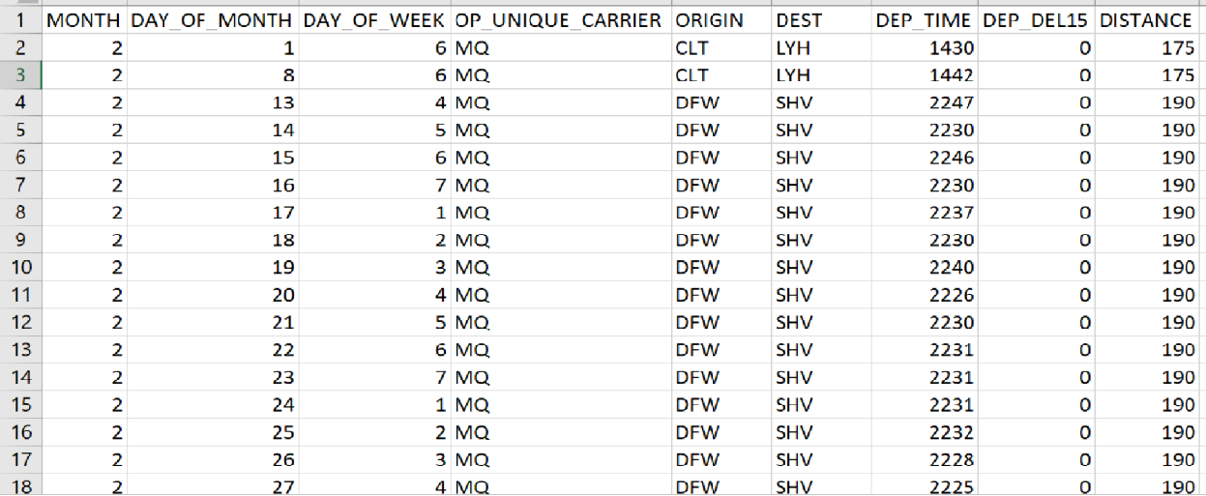
samples of our data set

Slide 5
Data set used
The data set contains more than 1000 samples.
The data set consists of data types.
INTEGER
FLOAT
Modeling
Binary classification
0=flights arrive on time
1=delayed flight

Slide 6
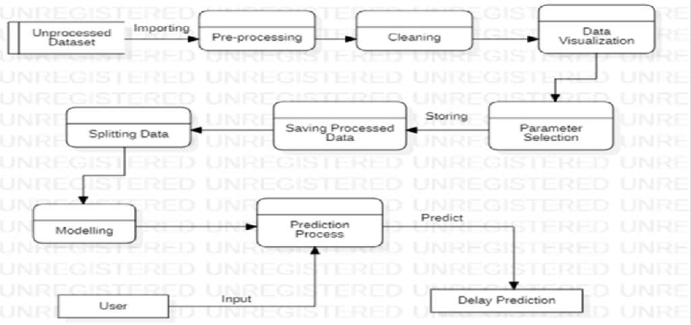
SYSTEM ARCHITECTURE:

Slide 7
Modules:
Module 1 : data collecting and pre-processing
Firstly,In the beginning of the phase, it is necessary that model inputs be determined so that based on them, model learn and result in final structure.
The dataset used for evaluating the model was obtained from historical data which contains flight schedules data for 5 years.
It is applied to real-world data collected from the airports in the U.S and is compared with existing flight delay predictors.

Slide 8
Module 2 : pre-training model- building
After pre-processing phase, second phase initiates, in which model enters pre-training phase that the training algorithm of a denoising autoencoder is summarized.
Normalized variables enter first denoising autoencoder as inputs and is mapped to first hidden layer.
Then, some of characteristics of X vectors inputs will be decayed randomly by rate of c. There are different methods to decay data and, in this study, used zero mask, meaning we change the value of those variables to zero and organize vector.

Slide 9
Module 3 : model optimization
The third phase’s goal is model optimization.When a network is formed, Weight and Bias values are distributed randomly among the nodes.
After determining the output, with its help, network error could be computed and then return the value along with Cost Function chart back to the network to update network’s Weights.
These Weights are updated in the way that decreases similar errors. This action is called back-propagation.

Slide 10
Algorithm used:
Decision Tree
Random forest
Logistic regression
Bayesian regression
Xg boost

Slide 11
Decision Tree:
As the name suggest the main idea behind decision tree algorithm is to make a tree like structure and get the answers in form of true or false. The model begins from a root node and ends on the decision. Each node receives a Yes or No question and answer is passed on to the next node. Root node gets all the input of the training dataset.
Random Forest :
Random Forest algorithm is an ensemble learning algorithm which uses Bagging. The Random Forest Classifier creates a number of Decision Trees.Random forest is a commonly-used machine learning algorithm trademarked by Leo Breiman and Adele Cutler, which combines the output of multiple decision trees to reach a single result. Its ease of use and flexibility have fueled its adoption, as it handles both classification and regression problems.Random forest algorithms have three main hyperparameters, which need to be set before training. hese include node size, the number of trees, and the number of features sampled. From there, the random forest classifier can be used to solve for regression or classification problems.

Slide 12
Logistic regression:
This type of statistical model (also known as logit model) is often used for classification and predictive analytics. Logistic regression estimates the probability of an event occurring, such as voted or didn’t vote, based on a given dataset of independent variables. Since the outcome is a probability, the dependent variable is bounded between 0 and 1. In logistic regression, a logit transformation is applied on the odds—that is, the probability of success divided by the probability of failure. This is also commonly known as the log odds, or the natural logarithm of odds.
Bayesian regression:
Bayesian linear regression is a type of conditional modeling in which the mean of one variable is described by a linear combination of other variables, with the goal of obtaining the posterior probability of the regression coefficients (as well as other parameters describing the distribution of the regressand) and ultimately allowing the out-of-sample prediction of the regressand (often labelled y) conditional on observed values of the regressors (usually X). The simplest and most widely used version of this model is the normal linear model, in which y given X is distributed Gaussian. In this model, and under a particular choice of prior probabilities for the parameters—so-called conjugate priors—the posterior can be found analytically. With more arbitrarily chosen priors, the posteriors generally have to be approximated.

Slide 13
Xg boost
XGBoost is an optimized distributed gradient boosting library designed for efficient and scalable training of machine learning models. It is an ensemble learning method that combines the predictions of multiple weak models to produce a stronger prediction. XGBoost stands for “Extreme Gradient Boosting” and it has become one of the most popular and widely used machine learning algorithms due to its ability to handle large datasets and its ability to achieve state-of-the-art performance in many machine learning tasks such as classification and regression. One of the key features of XGBoost is its efficient handling of missing values, which allows it to handle real-world data with missing values without requiring significant pre-processing. Additionally, XGBoost has built-in support for parallel processing, making it possible to train models on large datasets in a reasonable amount of time.

Slide 14
LITERATURE SURVEY:
Authors Name | Title of the Paper | Methodology | Future scope
Chakrabarty et al | Predicting flight delay with error calculation using machine learning classifiers | Chakrabarty et al used supervised automatic learning algorithms to predict delays in the arrival of operated flights including the five busiest US airports. | The model does not predict the accurate values and the data sets have many missing values.
Juan José Rebollo and Hamsa Balakrishnan | Predicting flight delay with error calculation using machine learning classifiers | used a hundred pairs of origin and destination to summarise the result of various regression and classification models. | The find outs reveal that among all the methods used, random forest has the highest performance
Sruti Oza, Somya Sharma | Predicting flight delay with error calculation using machine learning classifiers | used multiple linear regression to predict weather induced flight delays in flight-data, as well as climatic factors and probabilities due to weather delays | The forecasts were based on some key attributes, such as carrier, departure time, arrival time, origin and destination

Slide 15
